Slide 1
MEMORY MANAGEMENT
RIA HAQue

Slide 2
Computer memory

Slide 3
CODE

Slide 4
STACK

Slide 5
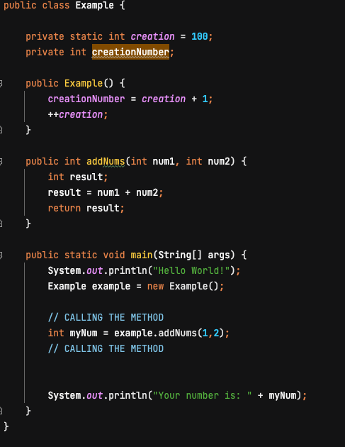
STACK
CALLING METHOD

Slide 6
STACK

Slide 7
HEAP

Slide 8
STATIC MEMORY

Slide 9
STATIC MEMORY CHANGING VALUE

Slide 10
MEMORY IS NOT INFINITE . . .

Slide 11
GARBAGE COLLECTION

Slide 12
REFERENCE COUNT

Slide 13
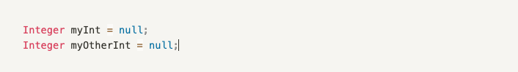

Slide 14
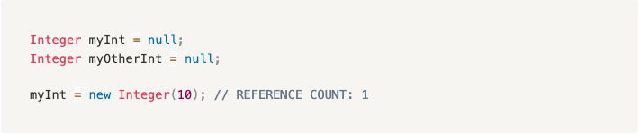

Slide 15
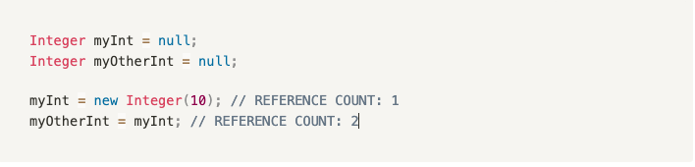

Slide 16
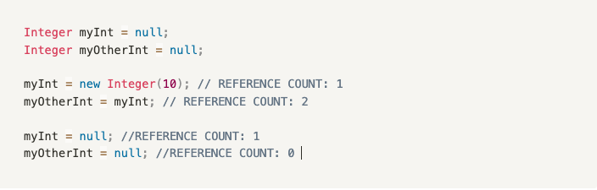

Slide 18
Unreachable Object

